Slide 1
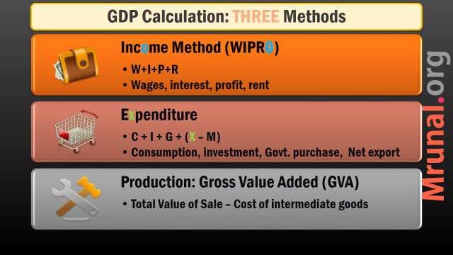
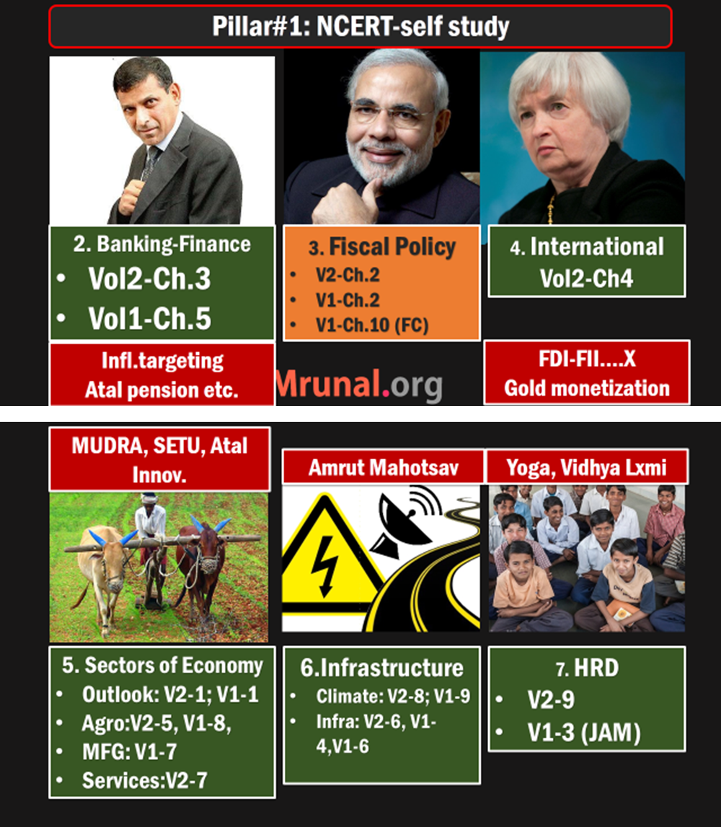
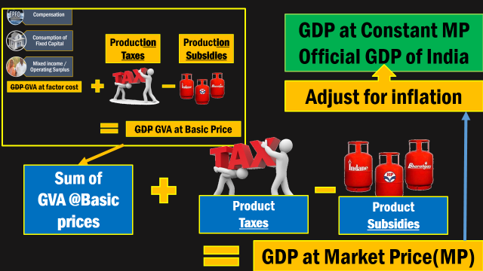

Slide 2
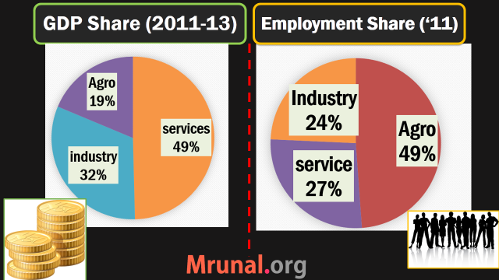
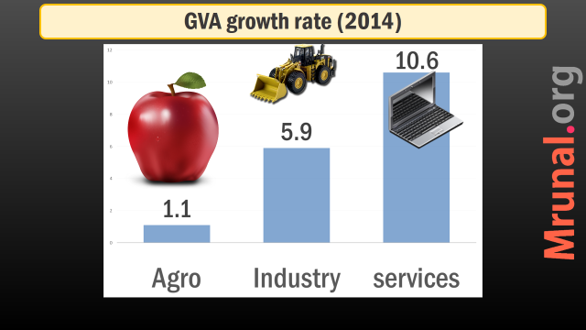

Slide 3
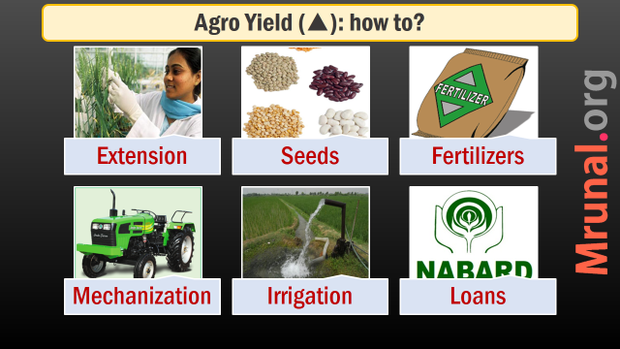
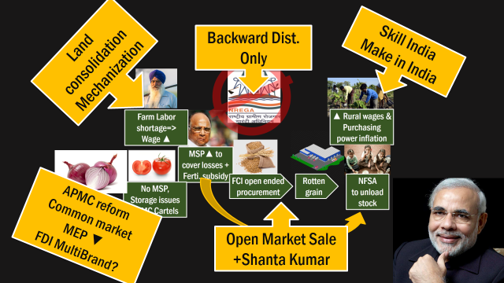
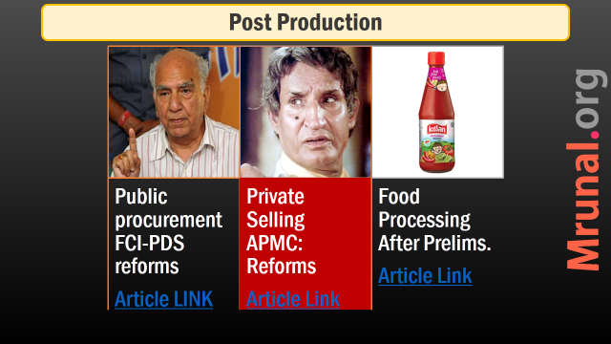

Slide 4
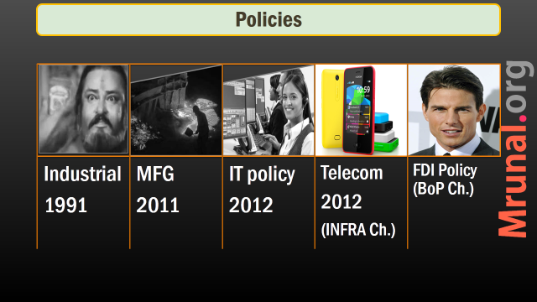
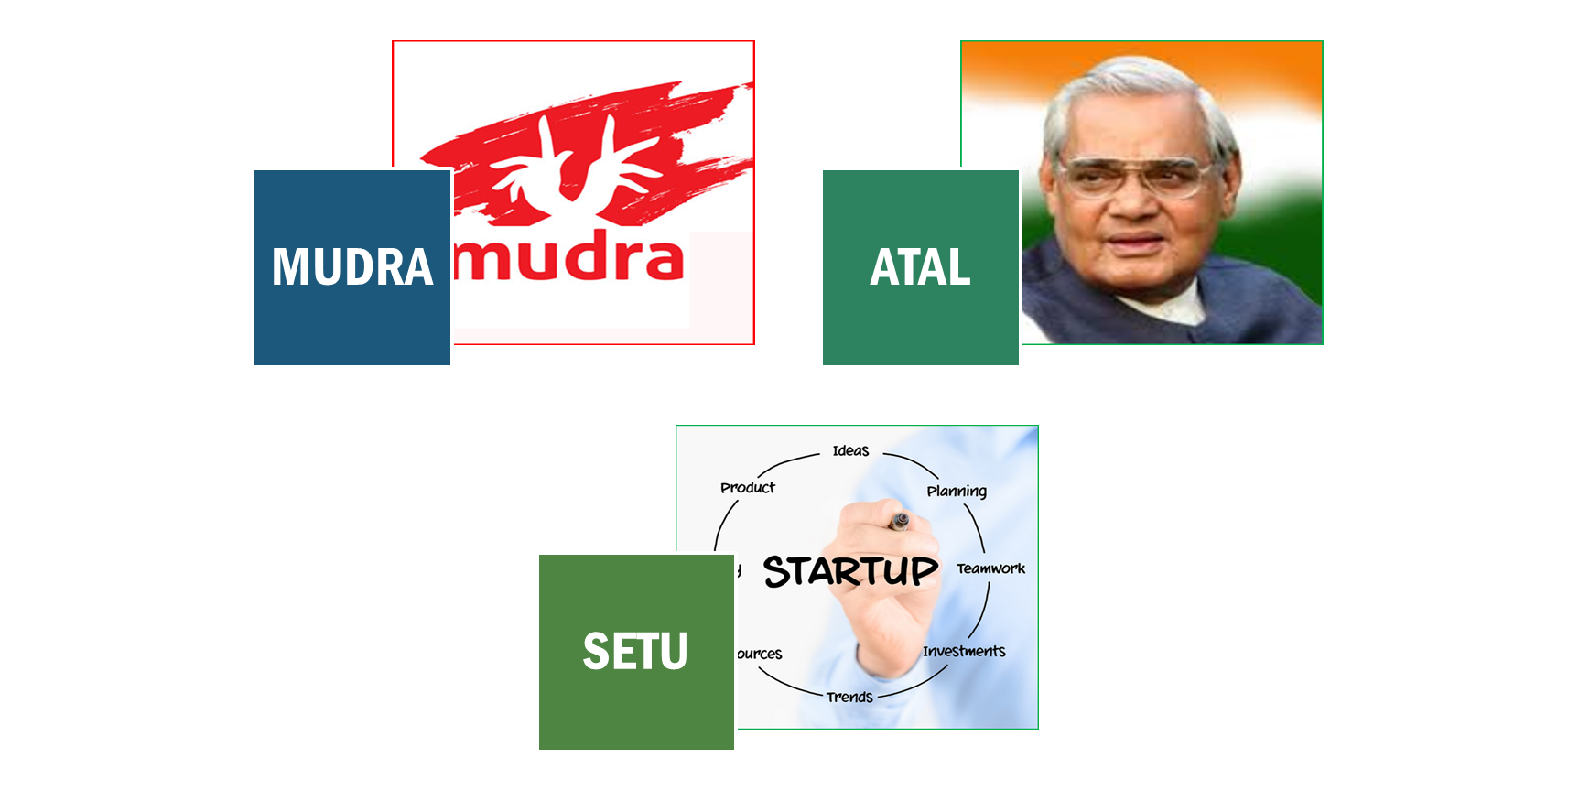
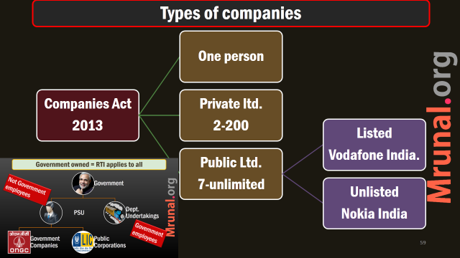
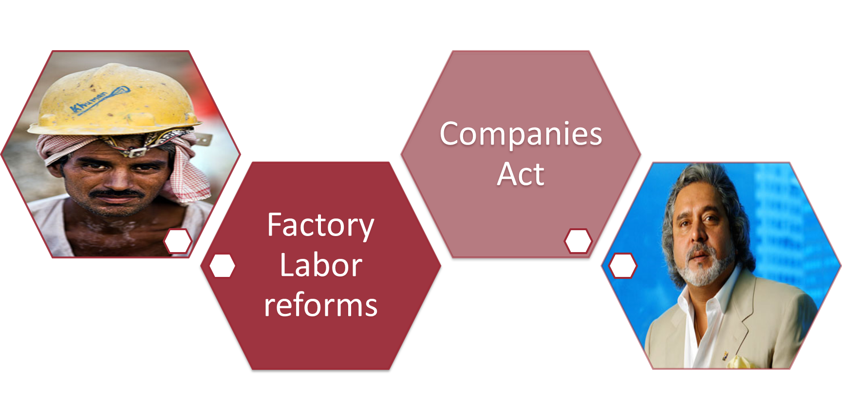



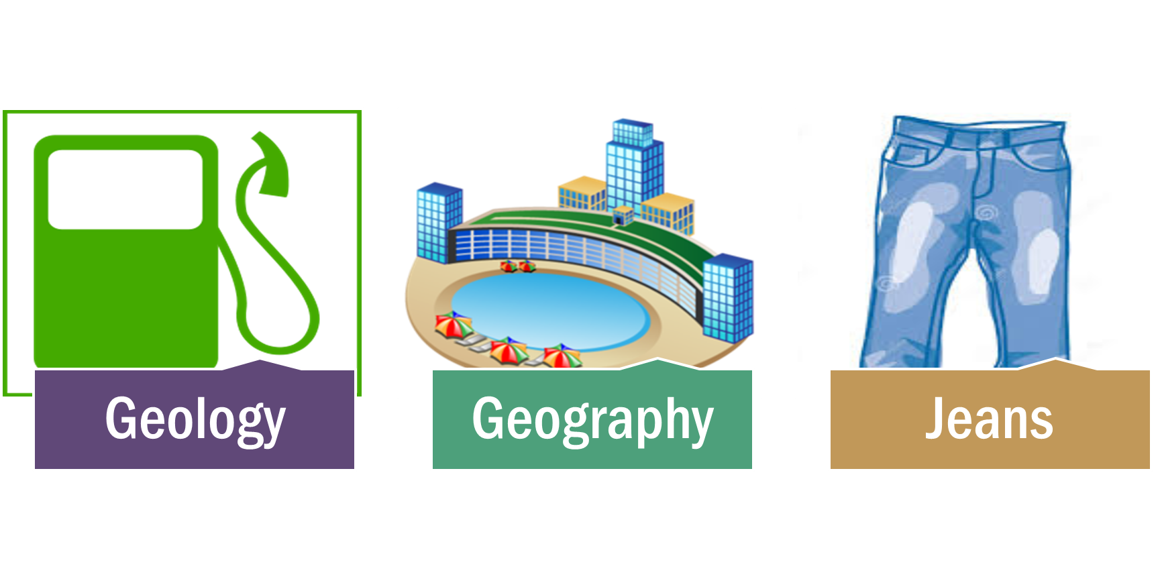

Slide 5

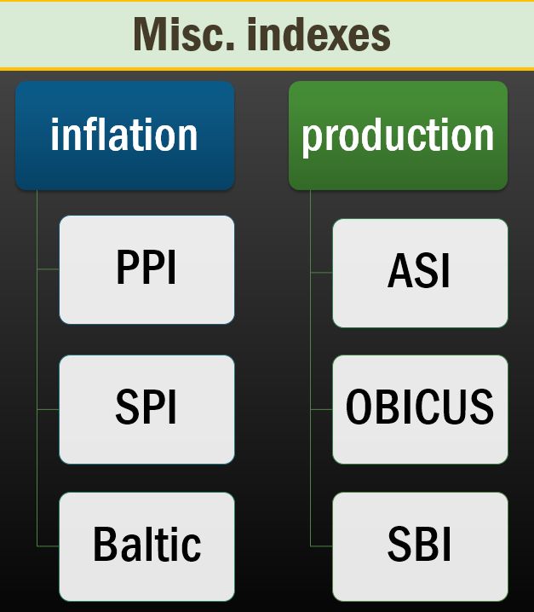
Today’s
Topic

Slide 6
International Trade
Budget 2015
Foreign Trade Policy 2015
Economic Survey 2014

Slide 7
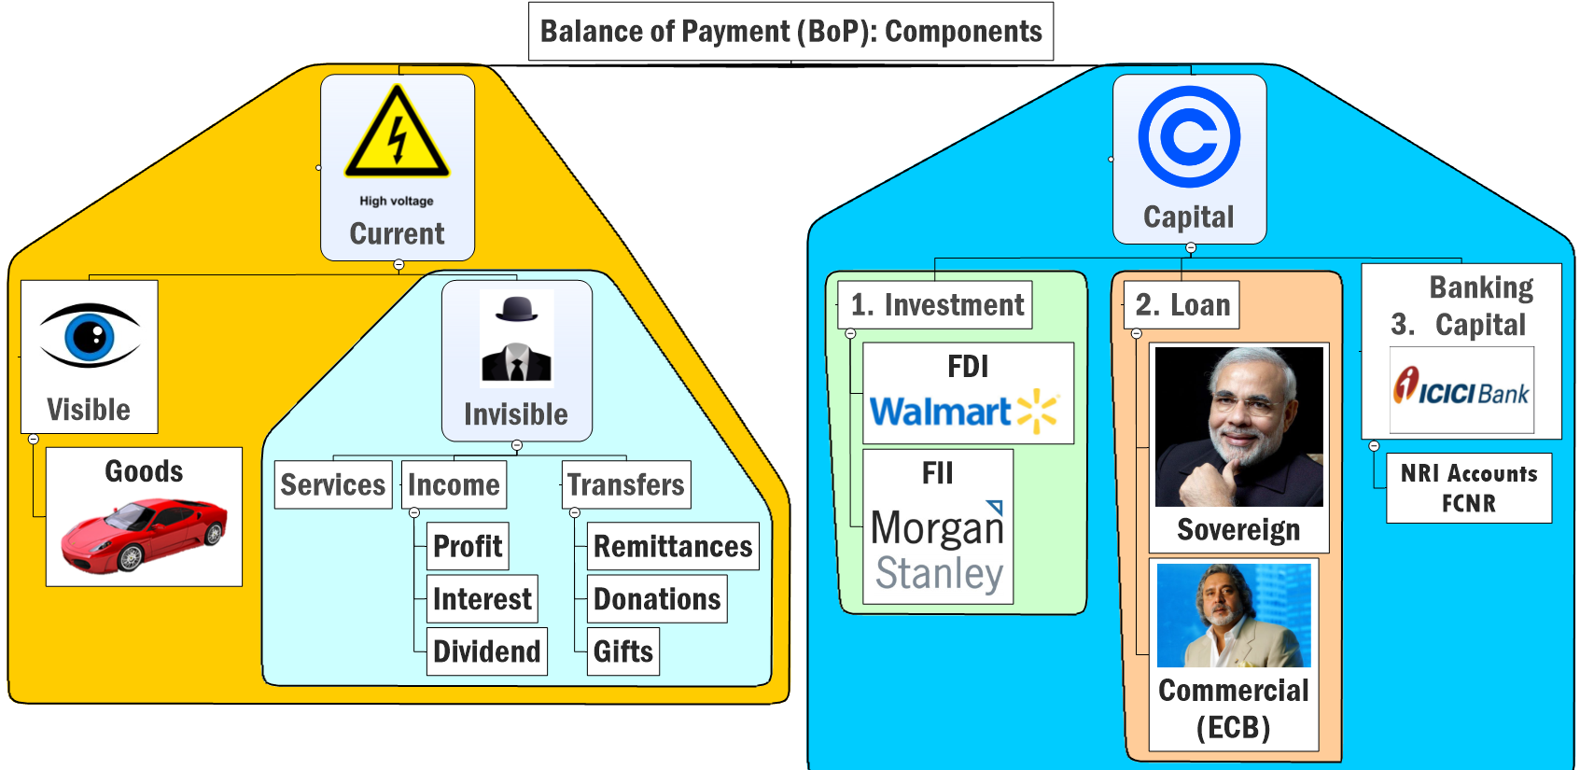

Slide 8
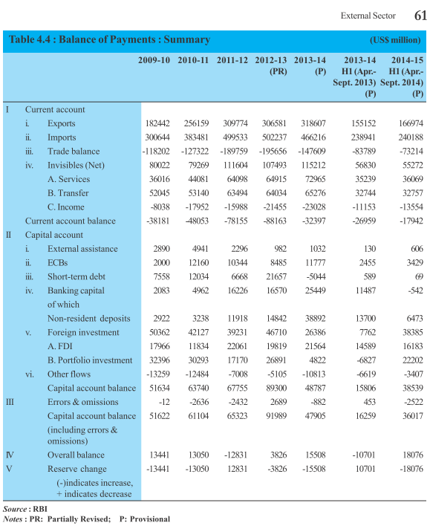
Import > Export = trade deficit
But 2014 < 2013 due to crude oil fall, less gold consumption
Invisible: Services > Transfer > Income
FPI > FDI
$$ outflow due to Fed.Tapering rumor = rupee weak (2013)
Forex increased for 2014-15

Slide 9
Trade deficit ▼ : Crude Price ▼, Gold consumption▼

Slide 10
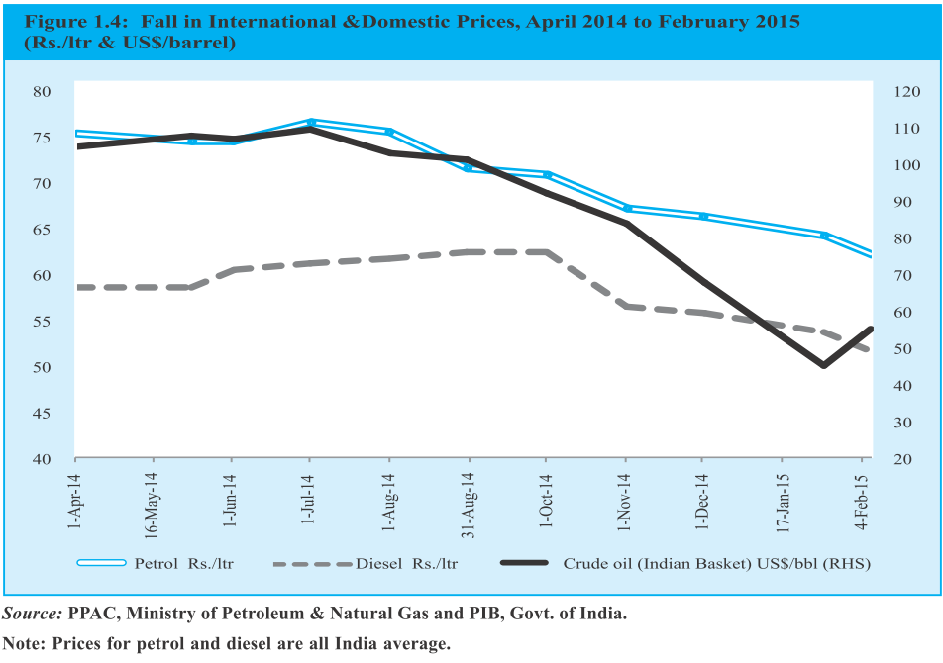

Slide 11
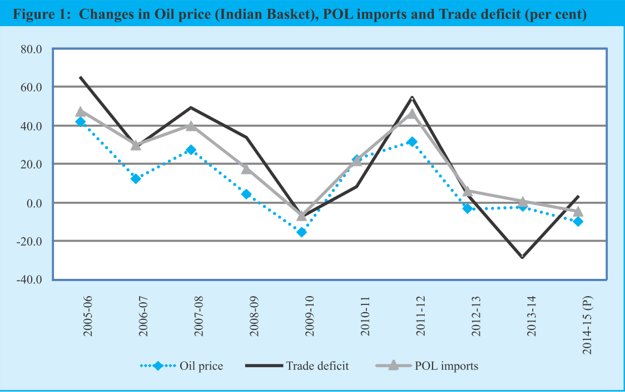

Slide 12
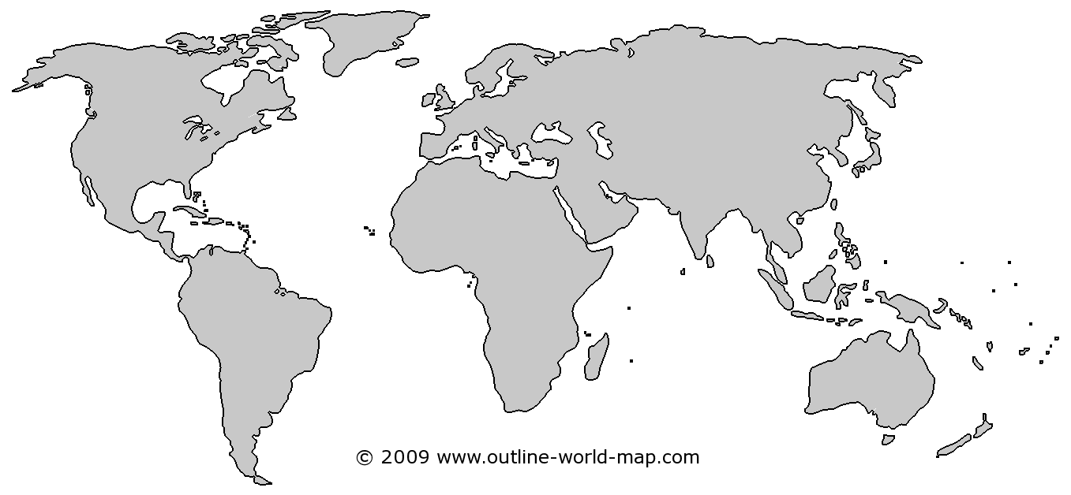
Oil expected ~60-65$ in 2015-16.
EU, China
growth▼
US: Shale Gas, Oil ▲
OPEC Oligopoly ▼
Saudi did not cut production
Notes:
from >100 per barrel to <50$
China, EU Growth▼=oil demand ▼
US oil + shale gas production ▲
OPEC oligopoly ▼, S.Arabia did not ▼ production
Survey predicts: $60-65 / barrel, so, inflation and CAD will be moderate for 2015-16

Slide 13

Lack of fin. Inclusion + black money park = Gold craze
Inflation
-ve Real Interest rate
Gold purchase
CAD ▲
Rs.▼

Slide 14
How to reduce consumption
Gold
Largest Gold importers (1) China (2) India.
custom duty on gold import increased from 2% to 10%.
But, NRIs shifted purchasing gold from Dubai, Singapore+ Smuggling.
Notes:
2% duty was in 2012
A plan by the Reserve Bank of India (RBI) to swap old gold in its vaults for purer metal abroad that it could pledge or sell would have the added benefits of reducing gold imports and easing pressure on the balance of payments.
The RBI would sell relatively impure gold from its own vaults - some dating back to before independence - and receive the equivalent worth of purer yellow metal delivered to the Bank of England, under a scheme outlined on Wednesday.
The swaps would not involve money changing hands, according to three officials aware of the development.
The RBI has parked gold abroad in the past, once in the throes of the 1991 financial crisis. It did a similar swap in 1998, according to a report at the time, before Russia's default and devaluation caused a meltdown across emerging markets.

Slide 15
How to reduce consumption
Gold
2013: 80:20 rule. 20% of gold must be re-exported (e.g. by jewelry making)
Inflation indexed bonds (positive real interest rate).
End result: 750 tonnes (2013)=>650 tonnes (2014)
Nov 2014: 80:20 restriction lifted by RBI
Notes:
2% duty was in 2012
A plan by the Reserve Bank of India (RBI) to swap old gold in its vaults for purer metal abroad that it could pledge or sell would have the added benefits of reducing gold imports and easing pressure on the balance of payments.
The RBI would sell relatively impure gold from its own vaults - some dating back to before independence - and receive the equivalent worth of purer yellow metal delivered to the Bank of England, under a scheme outlined on Wednesday.
The swaps would not involve money changing hands, according to three officials aware of the development.
The RBI has parked gold abroad in the past, once in the throes of the 1991 financial crisis. It did a similar swap in 1998, according to a report at the time, before Russia's default and devaluation caused a meltdown across emerging markets.

Slide 16
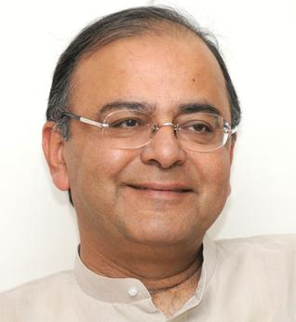
Purple=budget announced
Gold
Custom Duty (10%)
IIB
Monetization Scheme
Ashok Coins
80:20 Rule
Sovereign Gold Bond
Notes:
2% duty was in 2012
A plan by the Reserve Bank of India (RBI) to swap old gold in its vaults for purer metal abroad that it could pledge or sell would have the added benefits of reducing gold imports and easing pressure on the balance of payments.
The RBI would sell relatively impure gold from its own vaults - some dating back to before independence - and receive the equivalent worth of purer yellow metal delivered to the Bank of England, under a scheme outlined on Wednesday.
The swaps would not involve money changing hands, according to three officials aware of the development.
The RBI has parked gold abroad in the past, once in the throes of the 1991 financial crisis. It did a similar swap in 1998, according to a report at the time, before Russia's default and devaluation caused a meltdown across emerging markets.

Slide 17
Gold measures
Budget 2015
Did not cut custom duty (10%)
20k tonnes gold already in India
Need to get it traded or monetized
Existing gold deposit, gold loan schemes. => replace with Gold monetization scheme.

Slide 18
Gold monetization
Budget 2015
Depositor to earn “gold interest”
Jeweler to get gold loan in his account.
Expected to launch in May

Slide 19
Sovereign Gold Bond
Budget 2015
Fixed interest rate. (1-1.5%)
Redeem @Face value of gold @maturity.
PAN card must for transaction >1 lakh. (Black money curbed. Counter: very few have PAN cards in rural areas)

Slide 20
Gold coin
Budget 2015
Indian gold coin with Ashok Chakra on its face.
▼ imported Gold coins
Recycle Indian gold.
Standard quality

Slide 21
Purple=new
Gold
Custom Duty
IIB
Monetization Scheme
Ashok Coins
80:20 Rule
Sovereign Gold Bond
Notes:
2% duty was in 2012
A plan by the Reserve Bank of India (RBI) to swap old gold in its vaults for purer metal abroad that it could pledge or sell would have the added benefits of reducing gold imports and easing pressure on the balance of payments.
The RBI would sell relatively impure gold from its own vaults - some dating back to before independence - and receive the equivalent worth of purer yellow metal delivered to the Bank of England, under a scheme outlined on Wednesday.
The swaps would not involve money changing hands, according to three officials aware of the development.
The RBI has parked gold abroad in the past, once in the throes of the 1991 financial crisis. It did a similar swap in 1998, according to a report at the time, before Russia's default and devaluation caused a meltdown across emerging markets.

Slide 22

Impact on Indian Economy
Oil
Oil = 33% of import bill
Oil + gold = 45% of import bill.
$1 /barrel = $0.9 Billion import bill.
Overall, $9.5 billion less burden on Current Account (2014-15)
Same way $10 per Oz Gold => $130 million less
So, CAD, inflation both moderated

Slide 23
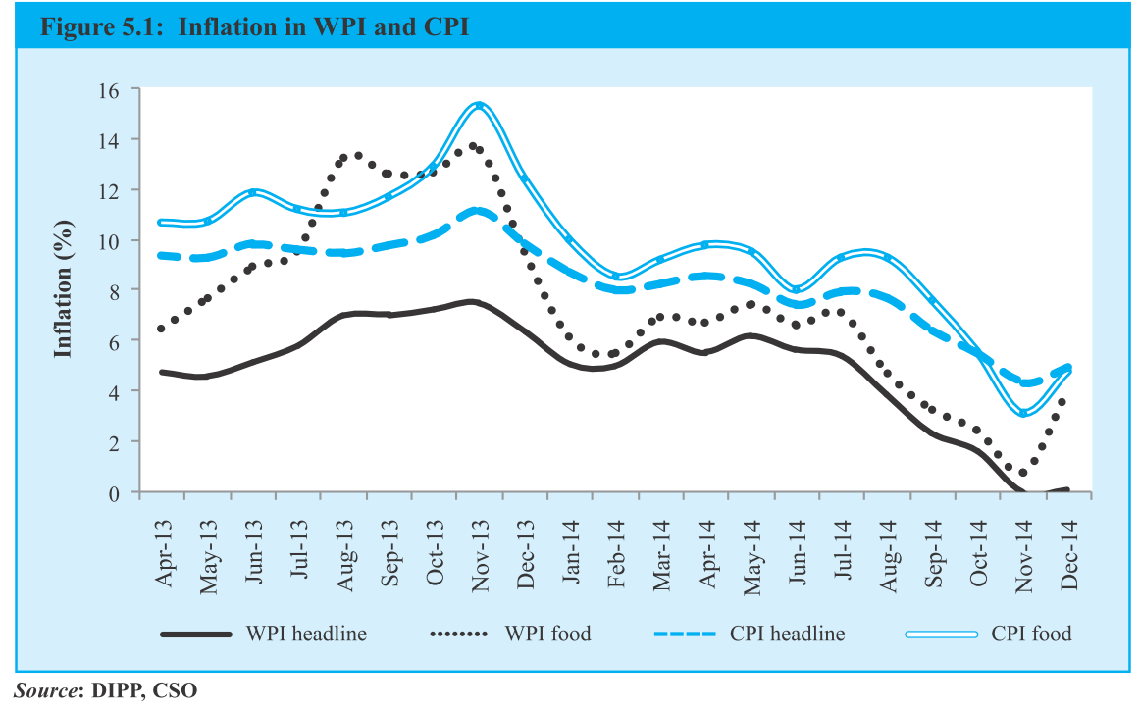
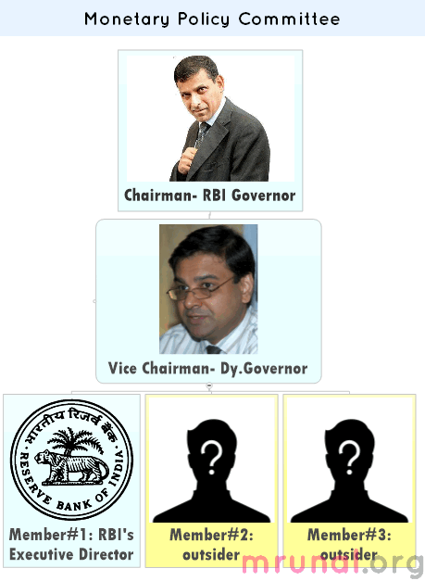
Inflation angles
Trade deficit Oil, Gold
Inflation (L5/P5)
Agro (L5/P2)
RBI (L1/P1)

Slide 24
Next topic: ranking- import, export top items

Slide 25





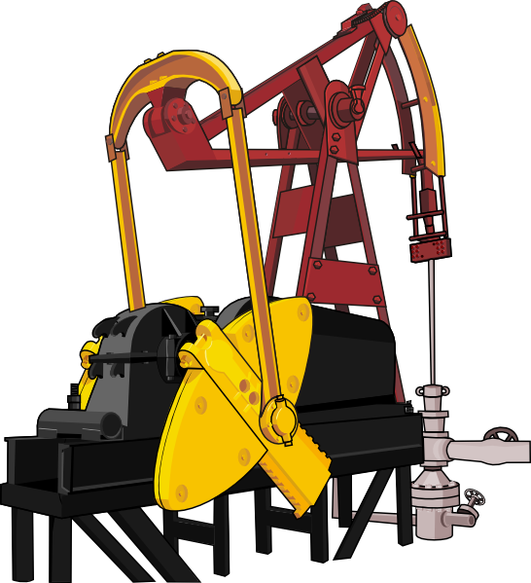
Top Exports (2014-15): Goods
Overall mfg. Goods = 63% of export
Export: GDP = 42%
India 19th Largest exporter
Machinery
Notes:
80% comes from these top seven items

Slide 26



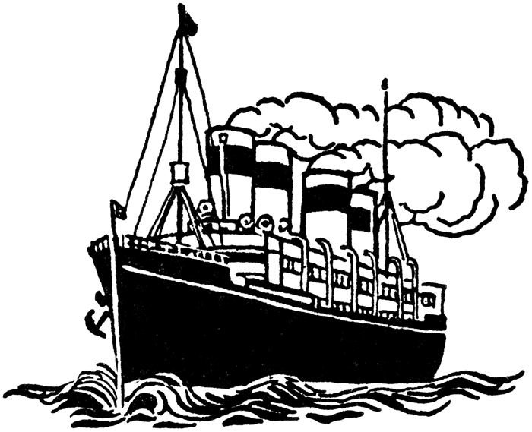

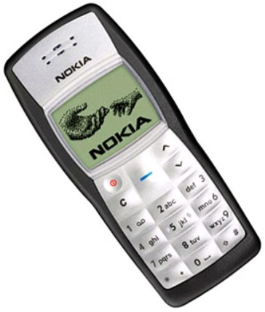
Top Export Services (2013-14)
Biz.
Travel
transport
Travel
Finance, pension, insurance
Telecom

Slide 27



Top Imports: Goods (2014-15)
Fuel (Petro+Coal)
>35% of total import
Capital Goods
India 12th Largest Importer
Gold & silver
Electronic
Goods
Pearls & Stones

Slide 28
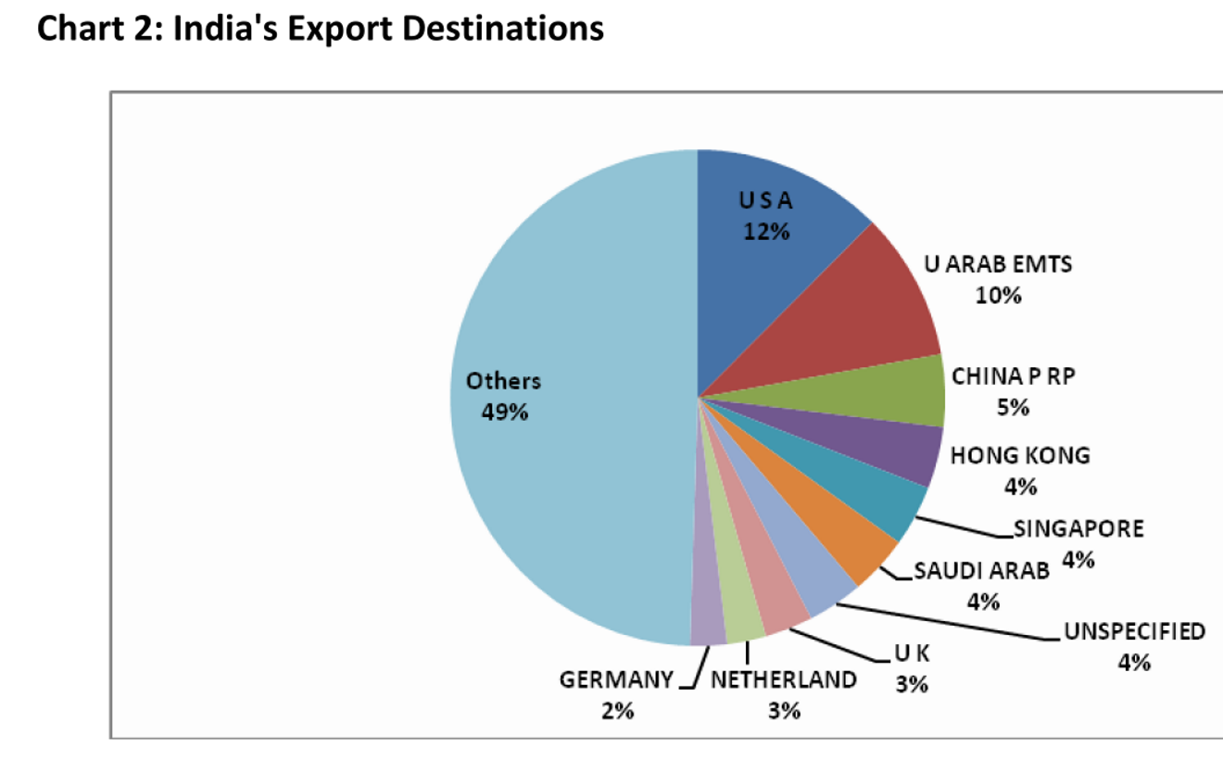

Slide 29
Overall : Trade Deficit but individual region differs
Trade surplus
Trade deficit
EU
USA
Africa
ASEAN
China
Middle East

Slide 30

Next topic: BOOST EXPORTS?

Slide 31
Boosting Exports
Why? Problems
How? Foreign Trade Policy
External
Domestic
Laws-taxes

Slide 32

External विदेशी कारण
Trade ▼
Slowdown in US,EU
QE by US (2008-2013)

Slide 33

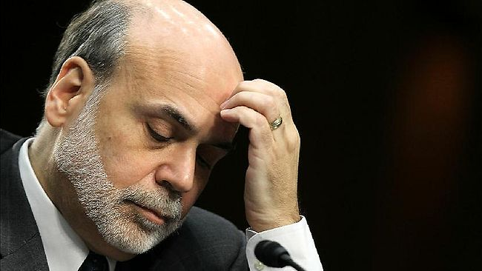


US Fed Reserve
Ben Bernanke
New money generated
85 Billion $ per month (Dec ‘13)
Fed buys
Treasury bonds and Toxic Assets
Notes:
In March, the ECB and national central banks of euro zone member states will start buying 60 billion euros of chiefly government debt each month. That figure includes rebundled private debt, asset-backed securities and covered bonds, typically worth about 10 billion euros, on top of the roughly 50 billion euros in state bonds. The plan is to buy until September 2016 or until there has been a "sustained" improvement in consumer price inflation, which recently turned negative. The programme could end earlier if successful, or be extended if its impact is small.
http://www.smh.com.au/business/markets/qe-explained-how-the-ecbs-quantitative-easing-plan-will-work-20150123-12wdji.html

Slide 34
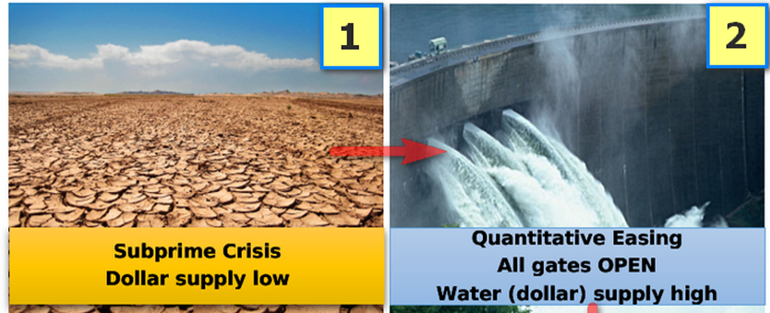
Hot money flow to India
$1: 39 Rupees = not good for Indian exporters

Slide 35
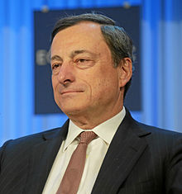
ECB Chairman
Mario Draghi
£60 billion/ month (from Mar’ 15
£10: private bonds
£50: State bonds
(BBB- or above)
Till Sep 2016 (or CPI ▲)
£ 1.1 trillion injected
Notes:
In March, the ECB and national central banks of euro zone member states will start buying 60 billion euros of chiefly government debt each month. That figure includes rebundled private debt, asset-backed securities and covered bonds, typically worth about 10 billion euros, on top of the roughly 50 billion euros in state bonds. The plan is to buy until September 2016 or until there has been a "sustained" improvement in consumer price inflation, which recently turned negative. The programme could end earlier if successful, or be extended if its impact is small.
http://www.smh.com.au/business/markets/qe-explained-how-the-ecbs-quantitative-easing-plan-will-work-20150123-12wdji.html

Slide 36
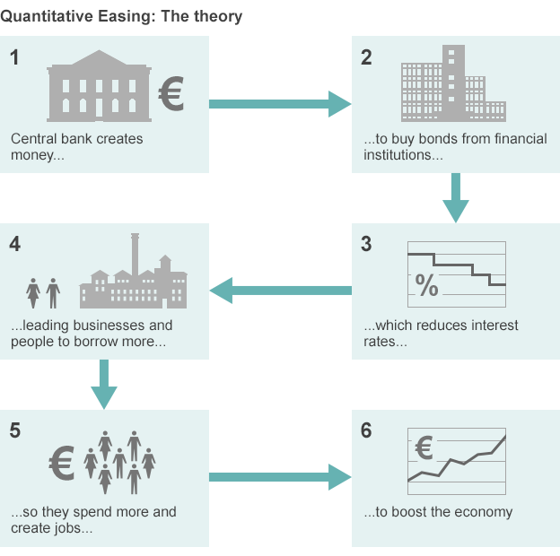
BBC chart
QE
Notes:
http://www.bbc.com/news/business-30933515

Slide 37
External विदेशी कारण
FTP-2015
QE in US and EU
Strong rupee => bad for exports
Regional trade agreements among giants esp. TPP

Slide 38
Boosting Exports
Why? Problems
How? Foreign Trade Policy
External
Domestic
Laws-taxes

Slide 39
Domestic देशी कारण
Export▼
Indian Inflation higher than world.
Infrastructure bottlenecks in highways, ports, Internet, electricity, water, gas.
State governments passive
Substandard products. Branding, packaging and advertising focus missing. "Zero Defect" required.

Slide 40
Boosting Exports
Why? Problems
How? Foreign Trade Policy
External
Domestic
Laws-taxes

Slide 41
Laws & Taxation
Trade ▼
GST delayed
High tariff on imported raw material
Tax terrorism. FDI restriction.
Industrial & labour laws
Stable agriculture export policy..X
high transaction cost: paper forms, inspection, inspector raj, red tapes.
Ease of doing Biz 2014: 142/189

Slide 42
Foreign Trade Policy?
Why Exports ▼?
How? Foreign Trade Policy
External
Domestic
Laws-taxes
Make in India
Skill India
Export promotion Mission
Digital India

Slide 43
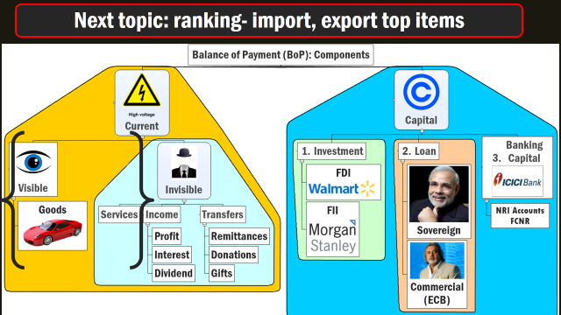
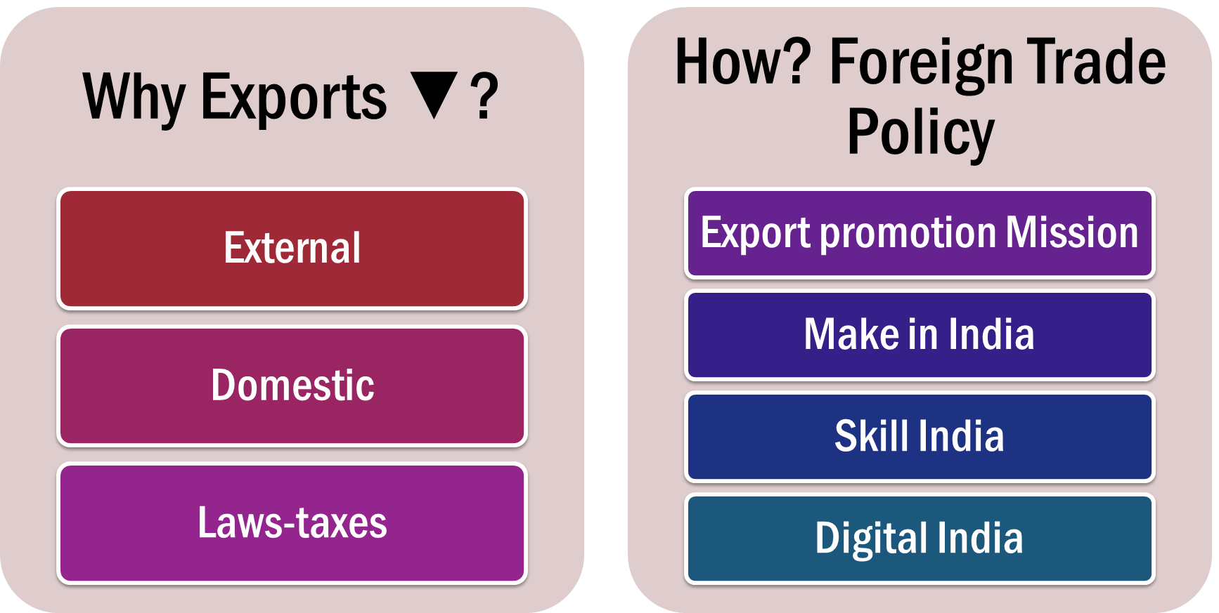
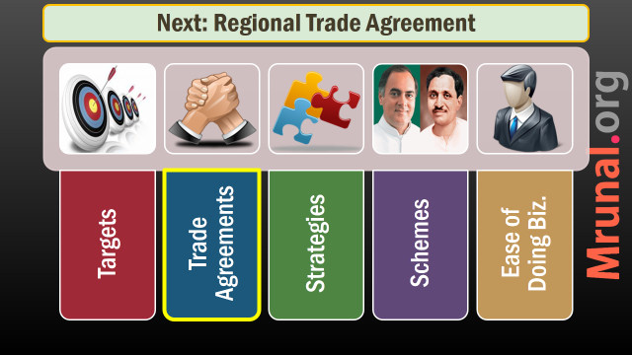
FTP-2015 to boost EXPORT

Slide 44
Boost Export HOW? = Foreign Trade Policy 2015-20
Strategies
Schemes
Ease of Doing Biz.
Targets
Trade Agreements

Slide 45

BASICS
FTP-2015
Under Foreign trade Development and regulation act 1992
Who? Director General of Foreign Trade (DGFT) under Commerce Min.
When? 2015-20. upto 31/03/2020

Slide 46

Export Targets
FTP-2015
Year | Export (US billions.) | World Share in Export
2013 | 465 | 2%
2020 31st March | 900 | 3.5%

Slide 47
Boost Export HOW? = Foreign Trade Policy 2015-20
Strategies
Schemes
Ease of Doing Biz.
Targets
900/3.5
Trade Agreements

Slide 48

Trade Agreements: WHY?
FTP-2015
WTO SPS/TBT: EU/US block entry of our goods. (e.g. Mangoes)
WTO food subsidies related issues.
WTO trade rounds dragged for decades without consensus.
Therefore, non-WTO Bilateral, multilateral and regional trade agreements to counter 1+2+3

Slide 49
5 Stages / evolution
PTA (7)
Common Market/Custom Union (MERCOSUR)
FTA, CECA, CEPA (11)
Multilateral / Regional TA
Economic Union (EU)

Slide 50
What’s the difference?
CECA, CEPA, BTIA
FTA
Comprehensive Economic Cooperation Agreements (CECAs)
Comprehensive Economic Partnership Agreements (CEPAs)
Broadbased Trade and Investment Agreements (BTIA)
Free trade agreement

Slide 51
What’s the difference? As per FTP-2015?
CECA, CEPA, BTIA
FTA
Goods
Services
Investment
IPR
Movement of people.
= more trade, jobs than FTA
Traditionally concerned with Goods only.

Slide 52

awareness
FTP-2015
Indian exporters unaware of FTA, SPS, TBT etc.
FAQ prepared http://Indiantradeportal.in

Slide 53
Mains: GS-2
Bilateral, regional and global groupings and agreements involving India and/or affecting India's interests
Multilateral trade agreements

Slide 54
1+2 = Erode Indian grip over US-EU markets
TPP
RCEP
TATIP
Together, 50% of world trade captured.
33% of World Trade
50% of population

Slide 55

TATIP
Agreements
Trans-Atlantic Trade and Investment Partnership
Between US and EU
~0% import duty for their products= India hurt.
Stringent quality norms, environment norms = Indian hurt.
E.g. pesticide residues in oranges (Nagpur vs Florida); Lead / heavy metals in mfg. goods/toy etc.

Slide 56
TATIP
Agreements
~0% import duty for their products= Tariff barrier for India, China
Stringent quality norms, environment norms, faster clearance to US/EU = Non-Tariff barrier for India China.
E.g. pesticide residues in oranges (Nagpur vs Florida); Lead / heavy metals in mfg. goods/toy etc.

Slide 57
1+2 = Erode Indian grip over US-EU markets
TPP
RCEP
TATIP
Together, 50% of world trade captured.
33% of World Trade
50% of population

Slide 58
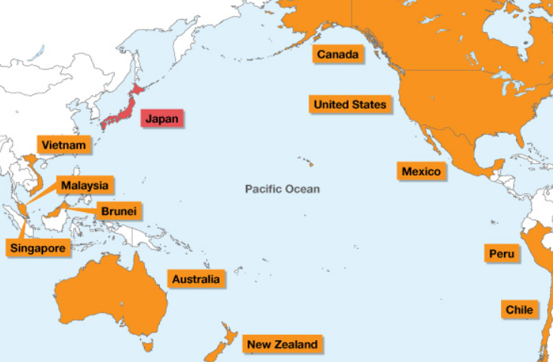
TPP: 12 members :USA + Canada + 10 Asia-Pacific

Slide 59
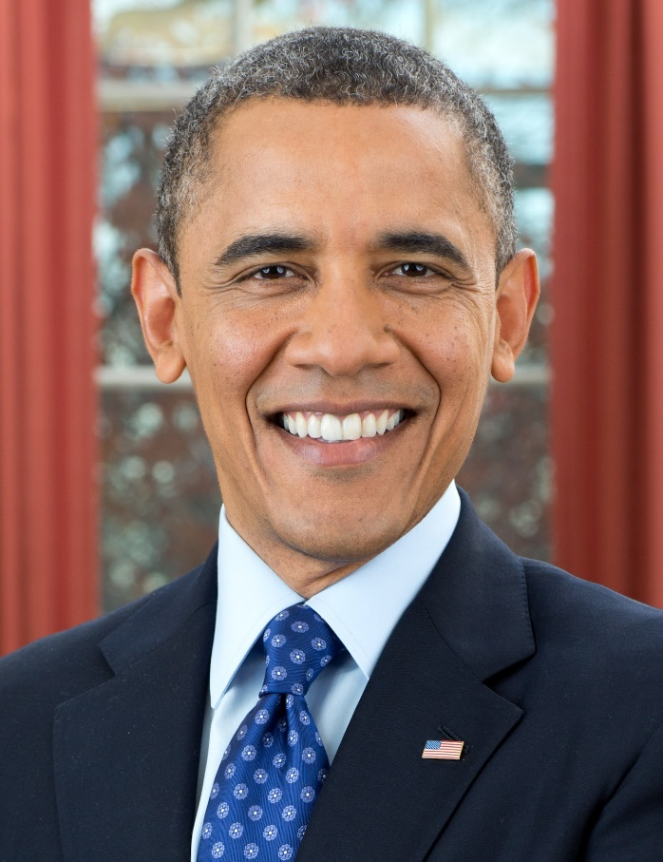
Salient Features
TPP
Trans pacific partnership
▲ Export of “Made in USA” goods and services.
Tariff barriers: 0%
Non tariff barriers: Minimal.
Sync. All partners with American environment, labour, IPR laws

Slide 60
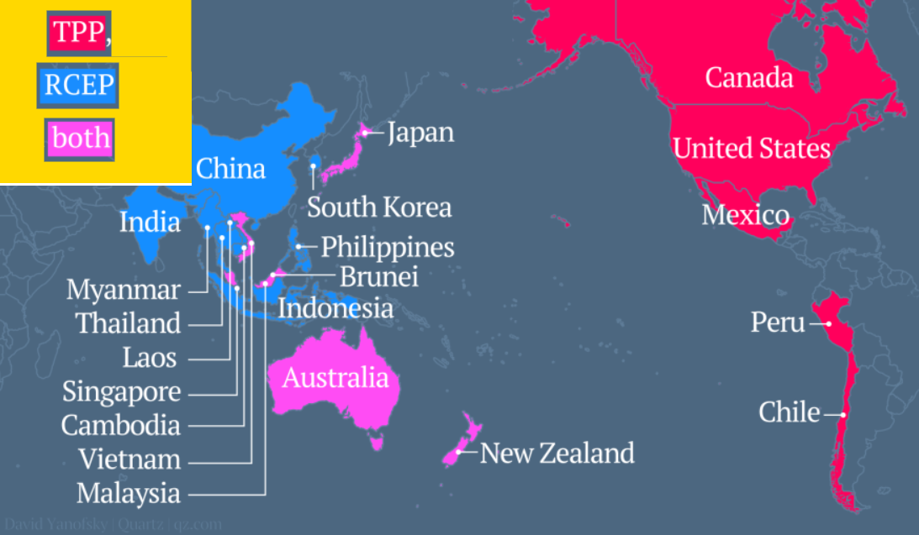
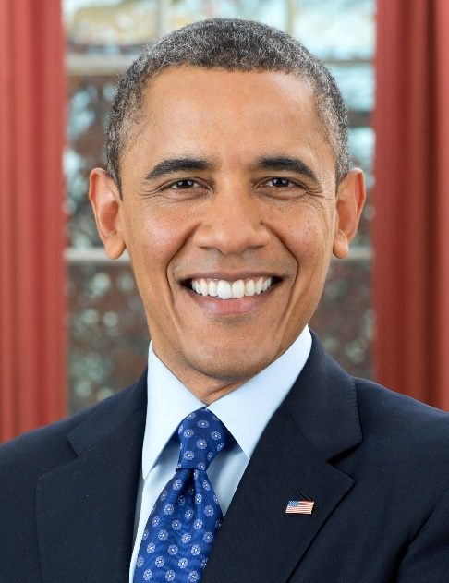
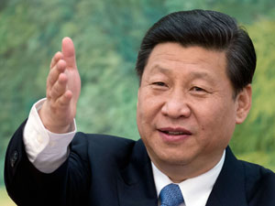
RCEP: China, India, ASEAN, Jap, Korea, Aus., NZ

Slide 61

If we don’t join TPP?
TPP/RCEP?
7 countries- Australia, Brunei, Japan, Malaysia, New Zealand, Singapore and Vietnam in both TPP and RCEP
EU QE+Slowdown = Indian Exports ▼
TPP+TATPI= tariff & non tariff barriers, in the name of environment, labour rights, IPR
RCEP weaker on above fronts (bcoz China itself gross violator).

Slide 62
India should join TPP?
RCEP/TPP
TPP: timing and terms yet unclear
If we want to join, then must reform environment, labour, IPR front in advance, to align with developed nations. (Economic Survey)
India cannot be a part of it coz our social-economic development goals. Compliance Cost high Agro, Mfg. & service industries. (FT-Policy 2015)
Notes:
Lead in paint
Server security

Slide 63
Mains / Interview
Examine the opportunities and constrains for India, in joining TPP. 150 words.
Easy Entry in 12 nations. Make outside India in Peru/Mexico => USA export.
Quality norms difficult to implement
If 0% tariff to American agro imports = Indian farmers hurt.

Slide 64
1+2 = Erode Indian grip over US-EU markets
TPP
RCEP
TATIP
Together, 50% of world trade captured.
33% of World Trade
50% of population

Slide 65
RCEP Members?
10 ASEAN
Brunei
Cambodia
Indonesia
Lao PDR
Malaysia
Myanmar
Philippines
Singapore
Thailand
Vietnam
6 ASEAN FT Partners
China
India
Jap
Korea
Aus.
NZ

Slide 66
RCEP
Trade grouping
India: a member.
Obligations to reform environment / Labour laws: not much.
Generous Exemptions to protect local industry: yes
lenient timetables for implementation: yes
Ideal to join such global value added chain. Produce in nearest low cost destination. (CMLV)

Slide 67
Mains / Interview
Discuss the significance of ASEAN-FTA and RCEP on India’s economic interests in Asia. 150 words.
TPP and RCEP- the Manifestation of Economic rivalry between US and China, will have profound impact on India’s foreign trade. Elaborate. 200 words.

Slide 68

Way ahead?
FTP-2015
~400 trade agreement in action among countries
India should Make agreements with countries where
India has potential market
India can source raw material / components.

Slide 69
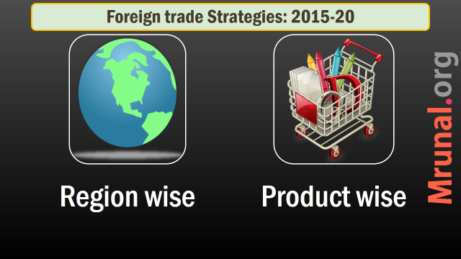
Strategies to boost EXPORT

Slide 70
FTP-2015: Region wise Strategies (8)
US,EU
China, Japan
SAARC
ASEAN
WANA
LAC
Russia,CIS
Africa

Slide 71
US/EU
FTP-2015
USA: back to growth part
Indian Gems and jewelry, agriculture to pickup.
But Trans pacific and trans Atlantic partnerships pose challenges.

Slide 72
European Union
FTP-2015
EU: largest trading partner of India
But, SPS, TBT used against Indian products (e.g. Mangoes & Vegetables)
Complex system of Tariffs and import quota.
Natural movement of Indian professionals difficult than in US

Slide 73

European Union
FTP-2015
Data security laws: only big Indian firms can enter.
Environment, child Labour laws.
IPR laws, patent issues.
Broad-based Trade and Investment Agreement (BTIA) under negotiation for years because of 1 + 2 + 3

Slide 74
EU Way Ahead
FTP-2015
Focus: defense equipment, medical equipment, construction material, processed foods
Discussing trade agreements with Turkey & Visegrad-4 (Czech Republic, Hungary, Slovak Republic, Poland)
Explore: Aus, NZ

Slide 75

Non-EU focus
FTP-2015
Australia: six crucial inputs: iron ore, coking coal, copper, gold, uranium and LNG
NZ: Expertise in dairy, meat and wool = sharing best practices and technology

Slide 76
FTP-2015: Region wise Strategies
US,EU
China, Japan
SAARC
ASEAN
WANA
LAC
Russia,CIS
Africa
Agro/ICT challenges
Explore non-EU

Slide 77
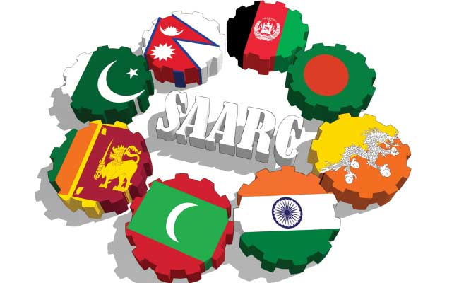
SAARC Present
FTP-2015
South Asian Association for Regional Cooperation
Mere 20 billion$ trade.
Largest trading partner: Bangladesh > Sri Lanka > Nepal > Pak.
0% duty market access given to L.D.C – Bhutan, Maldives et al.
problem: Pakistan

Slide 78
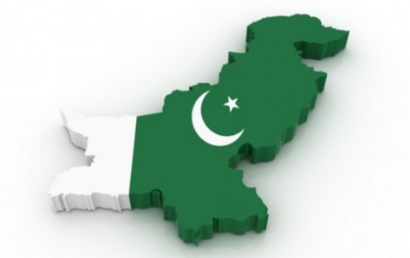
MFN from Pak
Policies
WTO: GATT, GATS =MFN concept.
If trade barrier lowered for most favored nation (MFN) then all trading partners be treated in same manner.
97: India gave MFN status to Pak

Slide 79
MFN from Pak
Policies
But pak still keeps ~1200 items India can't export- textile, agro, automobile parts = SMUGGLING
2012: new talks but stalled.
40% Pak-workforce in textile, vote bank-lobbying

Slide 80
SAARC Solution
FTP-2015
Prepare a 5-year action plan
Value added chain chains for textiles, leather, tourism, automobile, healthcare
Conclude SAFTA- in services.
Border Infrastructure
Multimodal connectivity.
SAARC Energy Grid (Article Link)

Slide 81
FTP-2015: Region wise Strategies
US,EU
China, Japan
SAARC
ASEAN
WANA
LAC
Russia,CIS
Africa
Env/ICT challenges
Explore non-EU
SAFTA service, Grid, Value added chain

Slide 82
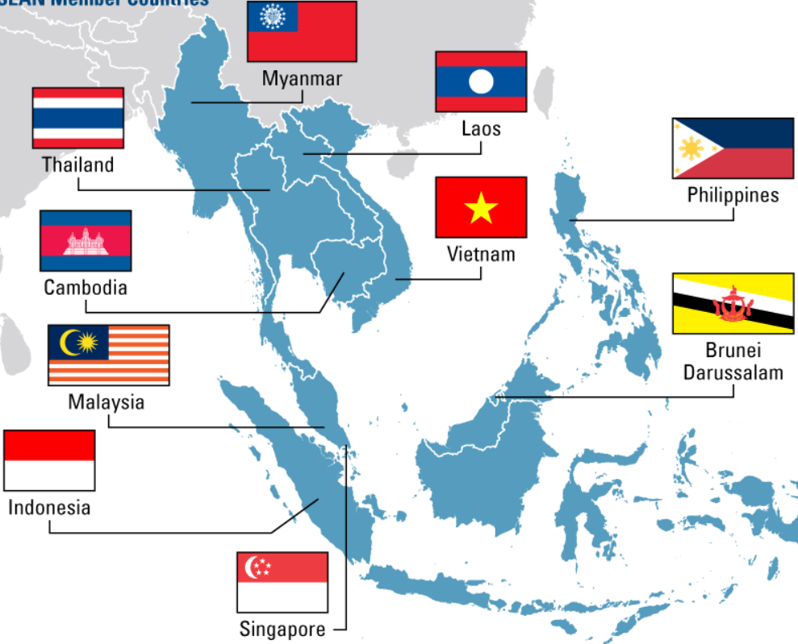
Association of South East Asian Nations (10)

Slide 83
India’s largest trading partner (decreasing order)
Singapore- FTA signed
Indonesia- FTA signed
Malaysia- FTA signed
Thailand- in progress

Slide 84

India ASEAN
FTA
FTA in Goods: 2009 sign ‘10 start
FTA in services: 2014= 9/10 ASEAN signed
Philippines: apprehensive of Indian IT/BPO competition.
FTA Services WEF: 1 July 2015

Slide 85
India ASEAN
FTA-Services
FTA in services and investment=8+1+1 pattern
1: with Philippines to safeguard their IT/BPO
1: with Indonesia to safeguard their service sector
8: agreements with remaining

Slide 86
BENEFITS?
FTA-Services
Easy movement of Man and money (investment)
By 2015: trade $100 billion
Joint review, dispute settlement
Later Regional RCEP with Aussies, China, SK, NZ and Japs

Slide 87
1st FTA with ASEAN, then joining RCEP
10 ASEAN
Brunei
Cambodia
Indonesia
Lao PDR
Malaysia
Myanmar
Philippines
Singapore
Thailand
Vietnam
6 ASEAN FT Partners
China
India
Jap
Korea
Aus.
NZ

Slide 88
ANTI?
FTAs
Mutual recognition of degrees needed. (Modi pitching for it)
Inverted duty structure.

Slide 89
Duty inversion
FTA
Import of Final goods = 0% (e.g. laptop from ASEAN)
Import of raw material = 10% custom duty (e.g. laptop battery) => India made laptop expensive than ASEAN laptop.
Import ▲ but export did not
Therefore FTAs hurting Indian economy.

Slide 90
ANTI-ANTI
FTAs
Comm.ministry expert panel: FTAs not culprit:
FTA have enough safeguards.
No data to prove dumping in India.
High cost of doing business.
Need to become part of Asian value chain. Get intermediate goods=>re-process=>export. (MAKE Outside India CMLV)

Slide 91
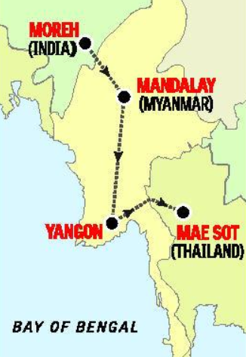
ASEAN Connectivity
FTP-2015
Myanmar borders with- 4 Indian states
Arunachal, Nagaland, Mizoram and Manipur
India-Myanmar-Thailand trilateral highway.
May extend to Cambodia, Laos, Vietnam (= make outside India)
Will be part of Asian Highway network AH-1. (= CMLV2China)

Slide 92
FTP-2015: Region wise Strategies
US,EU
China, Japan
SAARC
ASEAN
WANA
LAC
Russia,CIS
Africa
Env/ICT challenges
Explore non-EU
SAFTA service, Grid, Value added chain
FTAs: pro, anti
transport
(GS2) Bilateral, regional & global groupings and agreements involving India and/or affecting India's interests
(GS2) Effect of policies & politics of developed and developing countries on India's interests.

Slide 93
2016: China to amount for 25% of Our trade deficit
India
Export2 China
20 Billion
China
Export2 India
80 billion
Trade surplus

Slide 94
China why trade imbalance?
North Asia
China’s SOE (State Owned Enterprises) Opaquely control domestic IT-market.
Non tariff barriers on Indian food – pharmaceutical
Way ahead:
Explore film, tourism, entertainment service sector
Chinese investment in Indian mfg., SEZ, NIMZ

Slide 95
Pharma
FTP-2015
Approval to sell Indian drugs in China: need 3-4 years
Chinese drug regulator asks for detailed mfg. process, perform new clinical trials again in China.

Slide 96
How to ▼ trade deficit
China
Explore film, Buddhist-tourism, entertainment service sector
Chinese investment in Indian mfg., SEZ, NIMZ (“Make outside China”)

Slide 97

Japan
North Asia
Largest investor in Indian infra.
But trade potential untapped.
Language barrier
Unique market. (e.g. prefer flip phones instead of smartphones)
High service & quality standards
So, Market access = costly =not worth headache (says FTP-2015 indirectly)

Slide 98
FTP-2015: Region wise Strategies
US,EU
China, Japan
SAARC
ASEAN
WANA
LAC
Russia, CIS
Africa
Env/ICT challenges
Explore non-EU
SAFTA service, Grid, Value added chain
FTAs: pro, anti
transport
Tourism, makeoutside china
Market access difficult
(GS2) Bilateral, regional & global groupings and agreements involving India and/or affecting India's interests
(GS2) Effect of policies & politics of developed and developing countries on India's interests.

Slide 99
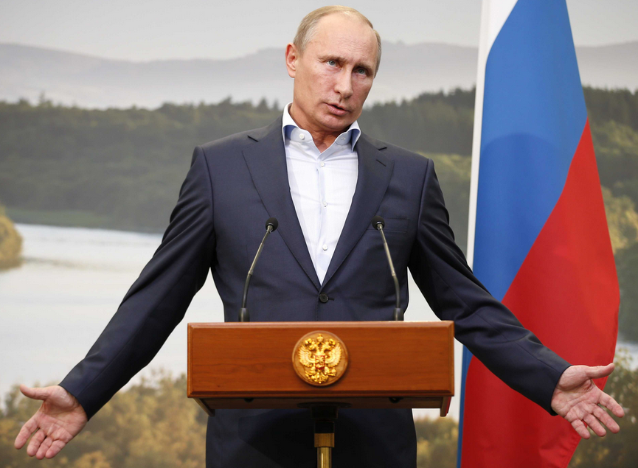
Russia
Eurasia
Strategic / defense relations: good
Trade relations: not so good.
Hardly 6 billion bilateral trade.

Slide 100
Russia
Eurasia
Custom clearance, pre-shipment inspection: complex and time-consuming
Russian importer needs to get license. Indian exporter has to pay his application fees!
product-specific approvals needed
SPS on Indian meat, egg, agro. Exports.
Banking and finance issues.

Slide 101
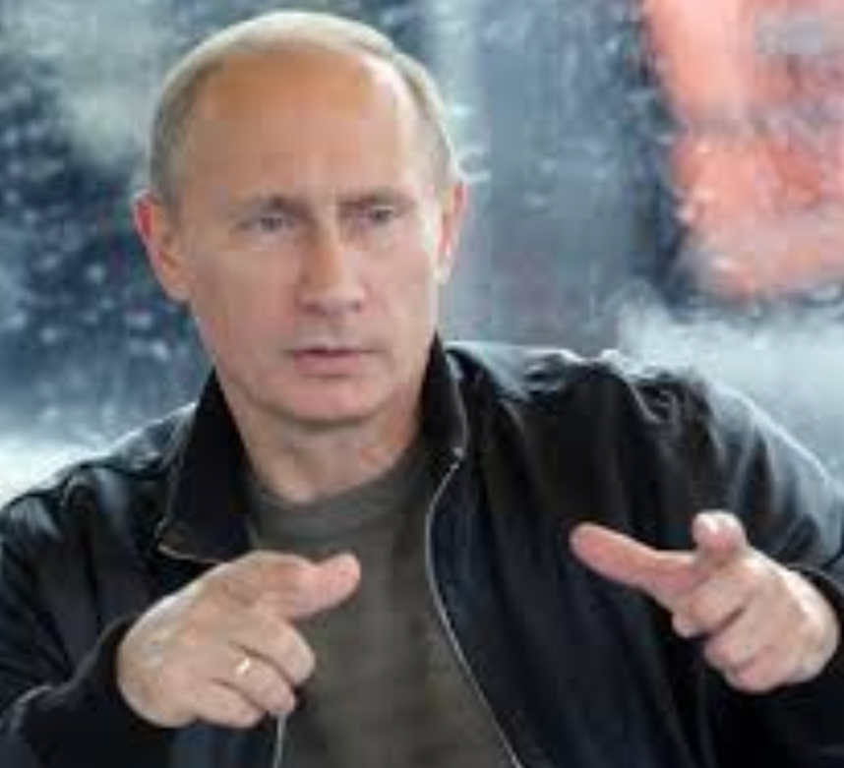
Russia Way Ahead
FTP-2015
Modi-Putin meet Dec. 2014
Joint statement
6 billion => 30 billion trade by 2025.
ALROSA, Russia’s largest diamond supplying company to sell rough diamonds to Indian cos. Directly. (~700 million$ per year)

Slide 102

CIS
FTP-2015
Commonwealth of Independent States
12 countries: Kazakhstan, Turkmenistan, Uzbekistan, Kyrgyzstan, Tajikistan, Russia, Georgia, Azerbaijan, Armenia, Ukraine, Belarus and Moldova
Market: yes per capital income high
Raw material: petroleum, coal, natural gas, potash, metals and minerals.

Slide 103
CIS Way Ahead
FTP-2015
Complementary to Indian Mfg. sector: both market + raw material.
Value addition => EU market
Present: Mumbai => Dubai => St. Petersburg (long and expensive)
Future: Mumbai => Iran => Astrakhan (Russia)
Mumbai => Crimea =>CIS.
International north south transport corridor in future
End result: cheaper, faster transport

Slide 104
FTP-2015: Region wise Strategies
US,EU
China, Japan
SAARC
ASEAN
WANA
LAC
Russia, CIS
Africa
Env/ICT challenges
Explore non-EU
SAFTA service, Grid, Value added chain
FTAs: pro, anti
transport
Market access difficult
Language barrier
Russia = problem
CIS = market + RAW + EU entry

Slide 105

WANA
FTP-2015
Six Gulf Cooperation Council | Bahrain, Kuwait, Oman, Qatar, Saudi Arabia and United Arab Emirates
Six West Asian | Iraq, Israel, Jordan, Lebanon, Yemen and Syria
Six North African | Algeria, Egypt, Libya, Morocco, Sudan and Tunisia

Slide 106
WANA
FTP-2015
190+ billion$ trade (1/4th of India’s trade)
Indian exports received well: tea, mangoes, automobiles
Way ahead: Conclude FTA talks with Israel and GCC
Issues: port Development (China unhappy), energy pipelines (Pak unhappy), defense ties (US/CPI unhappy)
Notes:
Israel defense cooperation. Energy pipelines.

Slide 107

Africa
FTP-2015
Domestic market, demographic dividend, abundant raw material
India given technical assistance for cotton cultivation => explore Egypt value added=> EU market entry
21 L.D.C given Duty free access, 0 visa application fees, tech. assistance.
“Project export” Potential yes, but political turmoils.

Slide 108
Africa way ahead
FTP-2015
Finalize trade agreements with following:
South African Customs Union (SACU)
Common Market for Eastern and South Africa (COMESA)
Economic Community of West African States (ECOWAS)

Slide 109
FTP-2015: Region wise Strategies
US,EU
China, Japan
SAARC
ASEAN
WANA
LAC
Russia, CIS
Africa
Env/ICT challenges
Explore non-EU
SAFTA service, Grid, Value added chain
FTAs: pro, anti
transport
Market access difficult
Language barrier
Russia = problem
CIS = market + RAW + EU entry
FTAs with Israel, GCC, SACU, COMESA, ECOWAS

Slide 110
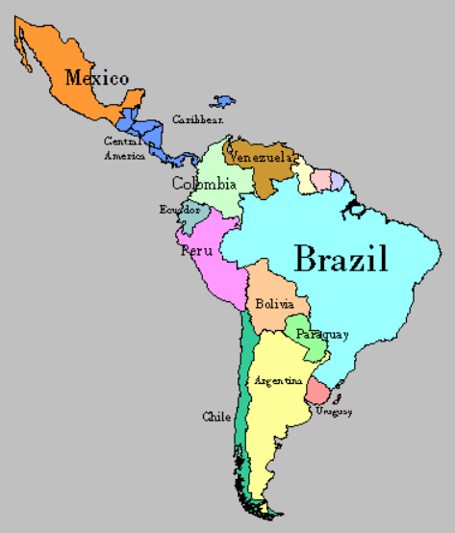
LAC
FTP-2015
Latin American and Caribbean
33 sovereign & 7 overseas territories
2009: PTA with MERCOSUR (Argentina, Brazil, Paraguay, Venezuela and Uruguay)
But non-starter, due to economic-political turmoil in the region

Slide 111
LAC Way Ahead
FTP-2015
Pacific Alliance: Peru and Colombia, Mexico and Chile. India an observer member 2014.
Explore large-scale farming by Indian companies/individuals = India's food security
Encouraging project exports in the LAC region by giving cheap loans.

Slide 112
FTP-2015: Region wise Strategies
US,EU
China, Japan
SAARC
ASEAN
WANA
LAC
Russia, CIS
Africa
Env/ICT challenges
Explore non-EU
SAFTA service, Grid, Value added chain
FTAs: pro, anti
transport
Market access difficult
Language barrier
Russia = problem
CIS = market + RAW + EU entry
Contract Farming
Project Loans
FTAs with Israel, GCC, SAU, COMESA, ECOWAS

Slide 113
Strategies to boost EXPORT

